Slide 1

Alternative Fuel Stations In California, Texas and New York Cody Osieczonek Ginger Francione Omar Hadi

Slide 2
Introduction
In recent years, people have become more worried about taking care of the environment and using fewer fossil fuels. This has led to a lot of interest in alternative fuels. These fuels are better for the Earth because they produce fewer harmful gases that contribute to climate change. The United States, being one of the biggest users of energy in the world, is also working to use more alternative fuels. In this introduction, we'll look at the different kinds of alternative fuels in the United States and where they are used. Some examples of alternative fuels are biodiesel, compressed natural gas, ethanol, hydrogen, liquefied natural gas, liquid propane gas, renewable diesel and electricity. Each fuel has its own advantages and challenges, which affect where they are used. We'll also explore the places where these alternative fuels are becoming popular. This is happening because the government is encouraging it, technology is improving, and more people are aware of the benefits. Understanding how alternative fuels are being used in the USA can help us make a cleaner and more sustainable energy future.

Slide 3
Top 3 Most Common Alternative Fuel Stations In United States
Between biodiesel (BD), compressed natural gas (CNG), ethanol (E85), hydrogen (HY), liquefied natural gas(LNG), liquid propane gas (LPG), renewable diesel (RD) and electricity there are a total of 73,464 stations combined at the time of this writing (this can vary since the API used in this project is using live data)
Of the above total alternative fueling stations 1324 are BD stations, 1445 are CNG stations, 4483 are E85 stations, 127 are HY stations, 134 are LNG stations, 2817 are LPG stations, 573 are RD stations and 62,561 of those are electric car charging stations
With this above data we can conclude that the top 3 most common alternative fueling stations in the United States are ethanol fuel stations, liquid propane gas fuel stations and electric car charging stations. In order to slim down the dataset we have decided to only include the data for these top 3 most common fuel stations in our project.

Slide 4
Top 3 Most Common Alternative Fuel Stations In California, Texas and New York
We have decided in order to further slim down the dataset we would narrow down the data of the top 3 most common alternative fuel stations to just the states of California, Texas and New York to give an idea of the differences in the amount of types of alternate fuel stations in different parts of the United States.
This trims our dataset down to a total of 25,110 total stations between the top 3 types combined in California, Texas and New York. Of those total 23,754 are electric car charging stations, 692 are E85 stations and 664 are LPG stations. It is obvious from this data the electric car charging stations are very popular.

Slide 5
Top 3 Most Common Alternative Fuel Stations In California
In California there are a total of 17,342 of the top 3 alternative fueling stations. Of that there are 16,731 electric car recharging stations, 354 E85 stations and 257 LPG stations. Needless to say if you went to travel in California with an electric car you would have a rather large abundance of electric car charging stations along whatever routes you are traveling
This means California’s top 3 alternative fueling stations are made up of approximately 96.5% electric charging stations, about 2.4% are E85 stations and about 1.1% are LPG stations.

Slide 7
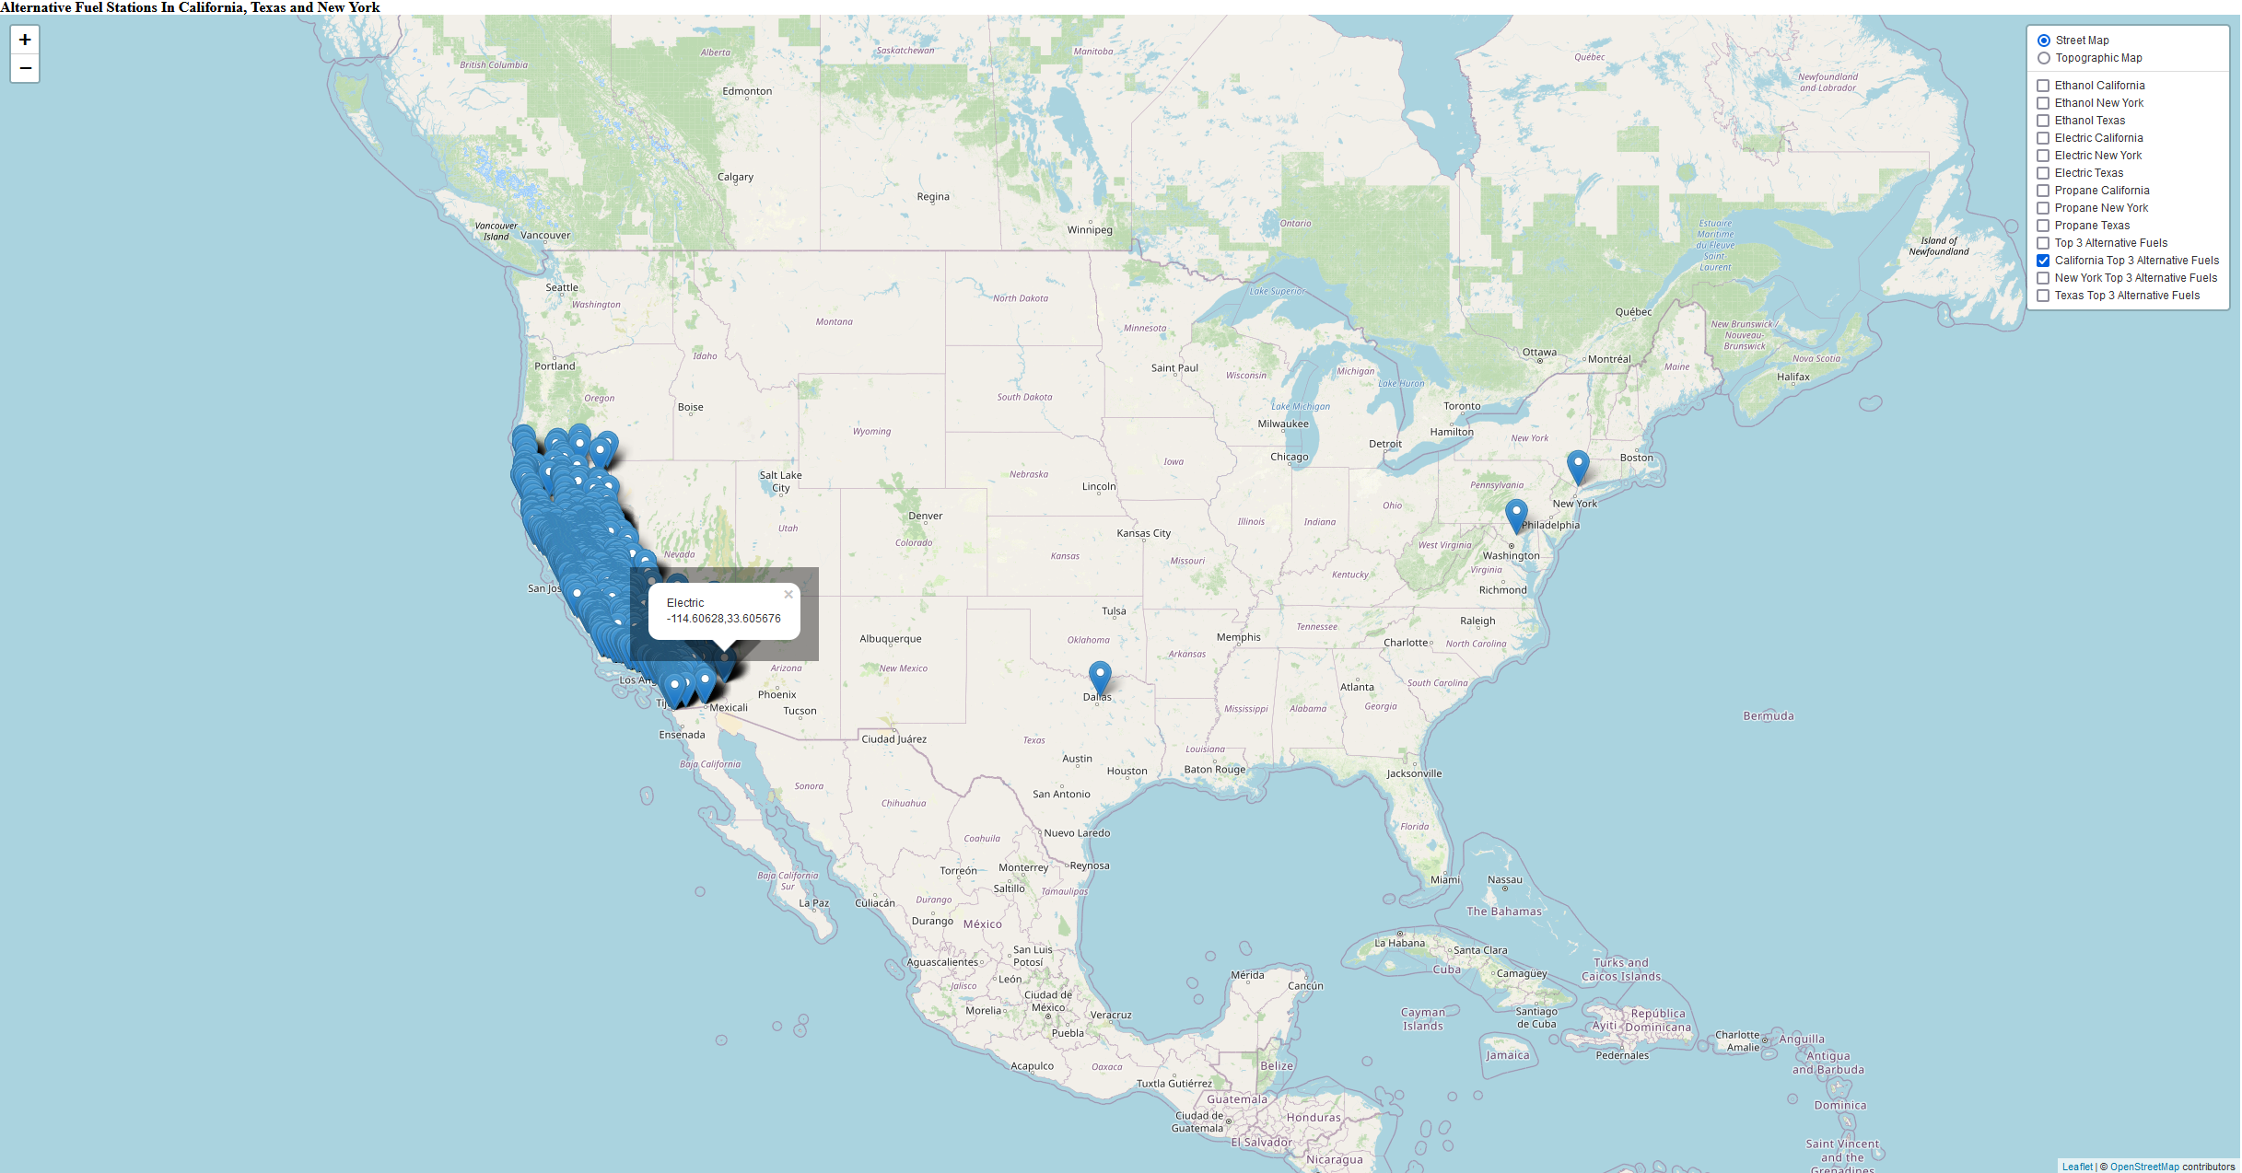

Slide 8
Top 3 Most Common Alternative Fuel Stations In Texas
In Texas there are a total of 3,624 of the top 3 alternative fueling stations. Of that there are a total of 3,002 electric car recharging stations, 264 E85 stations and 358 LPG stations. It is obvious from this data that Texas isn’t nearly as far along as California in terms of the number of electric car charging stations they have to use. They have some work to do.
This means Texas’s top 3 alternative fueling stations are made up of approximately 82.8% electric charging stations, about 7.3% E85 stations and about 9.9% are LPG stations.

Slide 10
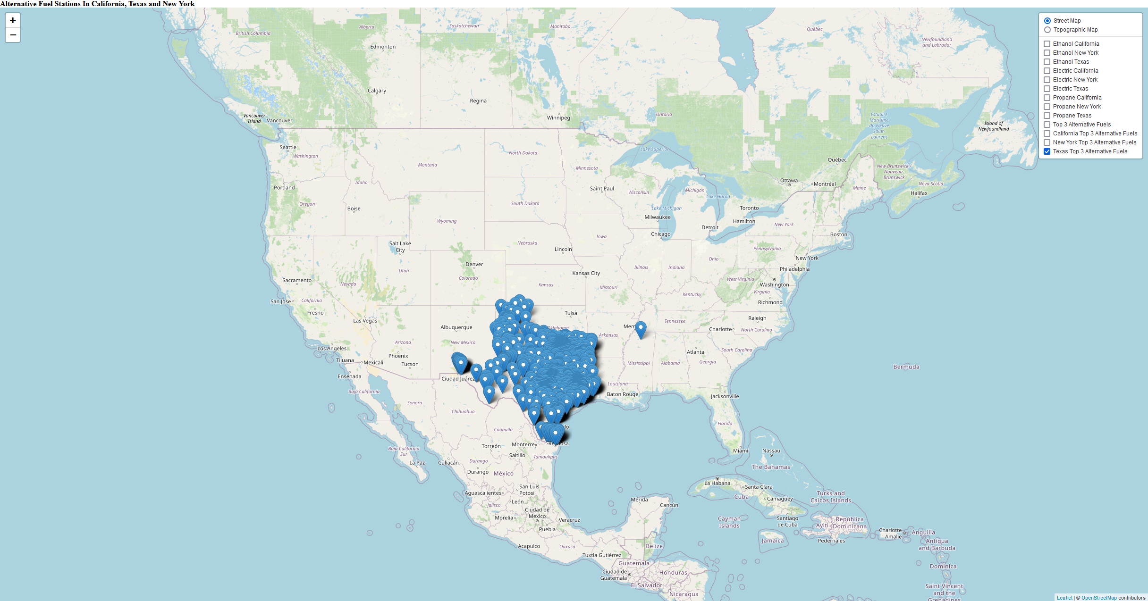

Slide 11
Top 3 Most Common Alternative Fuel Stations In New York
In New York there are a total of 4,144 of the top 3 alternative fueling stations. Of that there are a total of 4,021 electric car recharging stations, 74 E85 stations and 49 LPG stations. New York is a bit better when it comes to the number of charging stations to use compared to Texas but still only has less than 1/3 of the charging stations compared to California.
This means New York’s top 3 alternative fueling stations are made up of approximately 97% electric charging stations, about 1.8% E85 stations and about 1.2% are LPG stations.

Slide 13
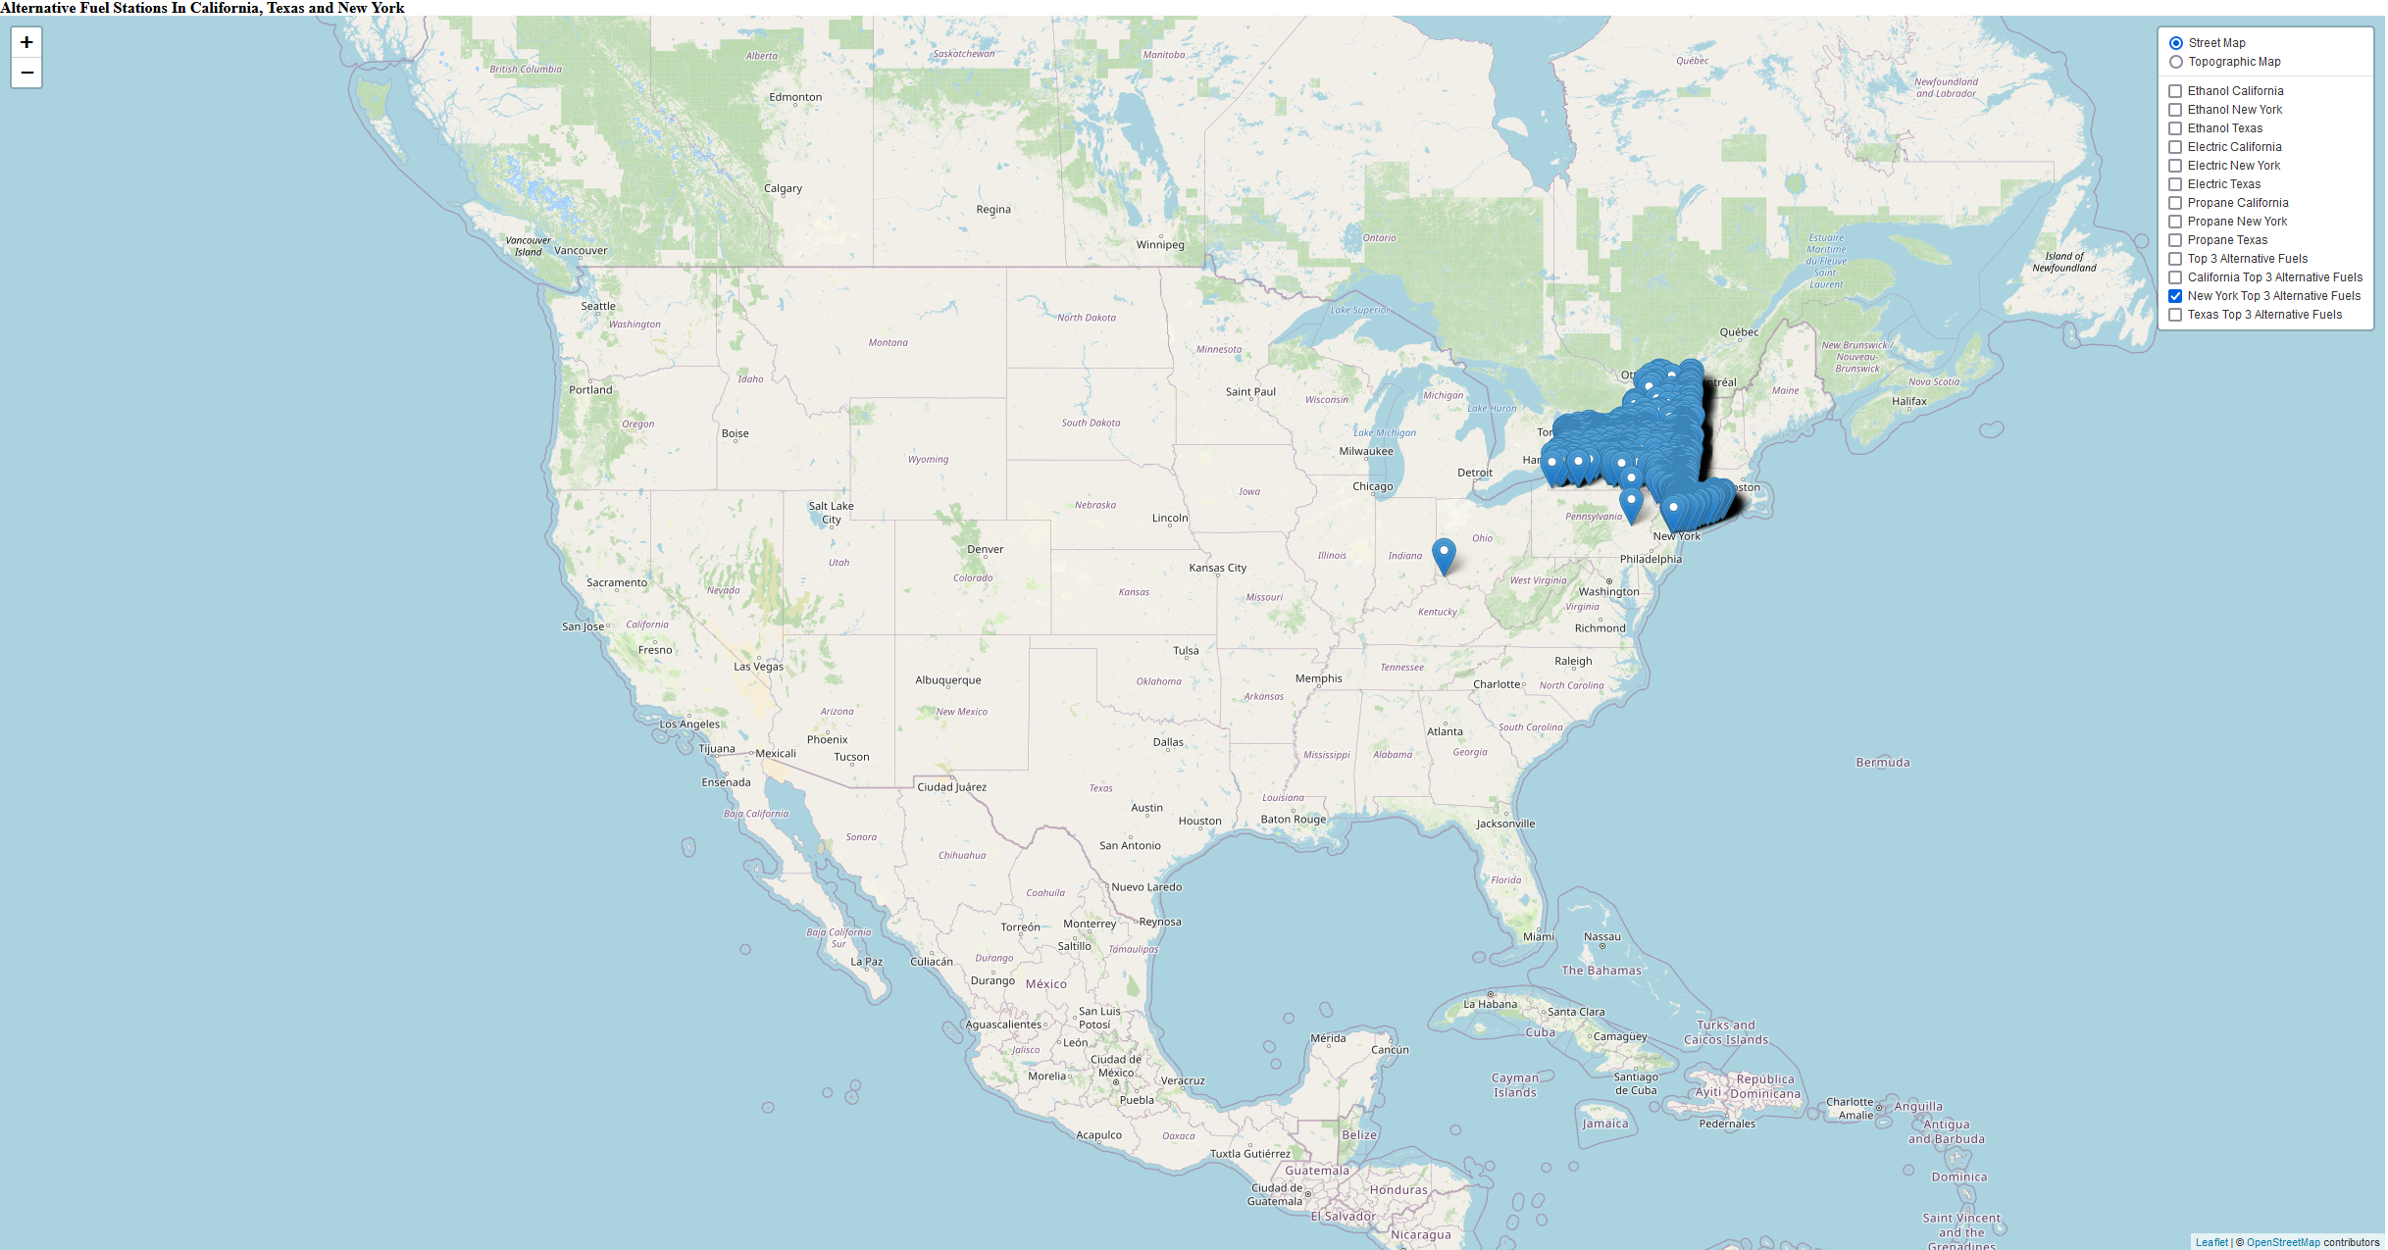

Slide 14
Conclusions
In conclusion if you have an electric car, then between California, Texas and New York, California will have the most electric car charging stations by a rather large margin. To give an idea here is some additional information:
Electric car charging stations make up about 70.43% of the total top 3 alternative fuel stations in California. They make up only about 12.64% of the fuel stations in Texas and only about 16.93% of fuel stations in New York
E85 fueling stations make up about 51.16% of the total top 3 alternative fuel stations in California. They make up only about 38.15% of the fuel stations in Texas and only about 10.69% of fuel stations in New York
LPG fueling stations make up about 38.70% of the total top 3 alternative fuel stations in California. They make up only about 53.92% of the fuel stations in Texas and only about 7.38% of fuel stations in New York

Slide 16
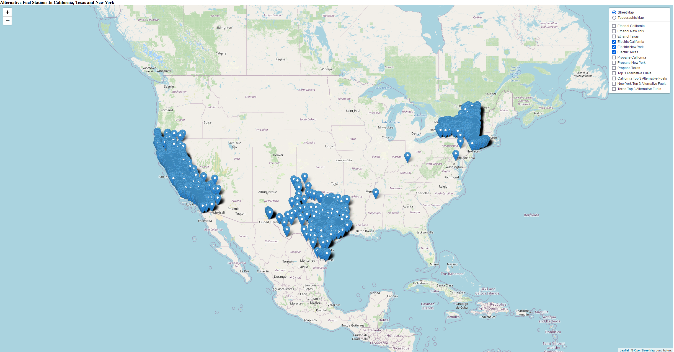

Slide 18
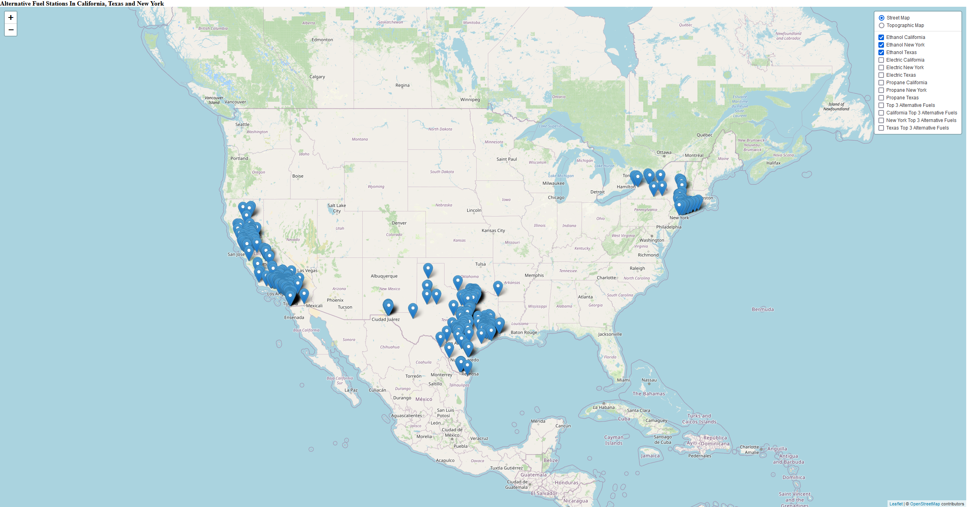

Slide 20
